Slide 1
01
Objective

Slide 2
To create a digital twin of multistage crosscurrent liquid - liquid extraction using right angle triangle method in MATLAB
A simulation framework using solvers present in MATLAB
Also to create a graphical user interface so that various equilibrium data can be entered after choosing crosscurrent LLE
To plot
Extract vs composition for each stage
Percentage removal at each stage
Heat map of concentration for all stages
To generate response surface and optimisation of the process

Slide 3
02
Flow chart

Slide 4
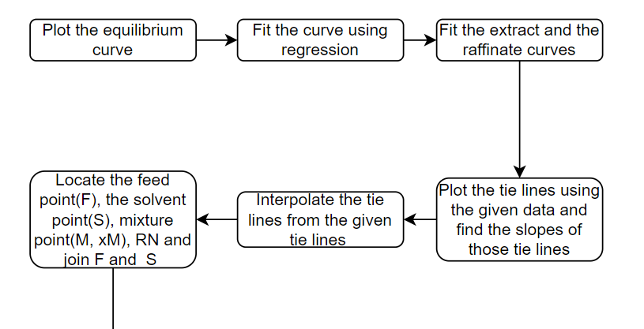

Slide 5
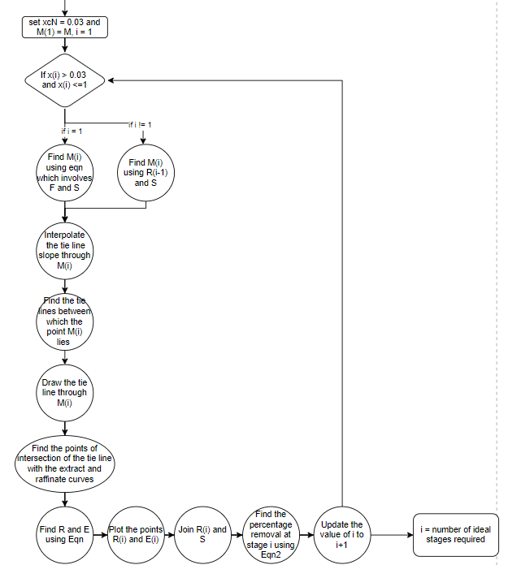

Slide 6
03
Equations used in the model

Slide 7
Mass balance:
F+S=M;(F=feed;S=solvent) and F*xcf+S*ycs=M*xcm
Using the material balance equations and tie lines data we plot a graph(xb , yb vs xc ,yc) and find the indices corresponding to given lines.
Here we are finding the coordinates of Mixture point based on Feed and solvent for the 1st stage and Based on Raffinate and solvent for the rest of the stages.

Slide 8
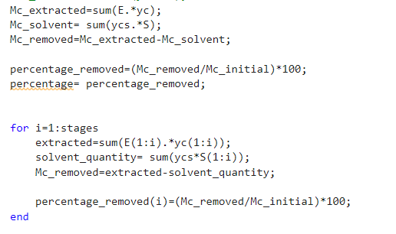
Percentage removal
Total
Mc_extracted = mass of solute in extract phase
Mc_solvent = mass of solute in solvent
Mc_removed = mass of solute removed from the feed
At each stage
extracted = mass of solute in
extract phase at stage i
solvent_quantity = mass of solute in solvent
at stage i
Mc_removed = mass of solute removed from the feed
at stage i

Slide 9
04
Specific functions used from MATLAB

Slide 10
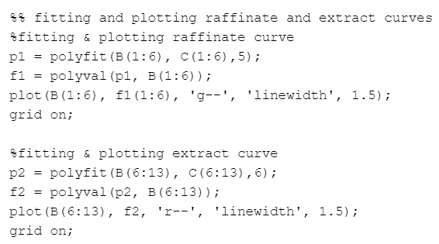
Using polyfit to fit the equilibrium curve into extract and raffinate curves

Slide 11
Finding coordinates at each stage using fzero function
Using fzero we find the intersection point of the tie-line passing through the M(i) point with the extract and raffinate parts of the equilibrium curve.
We tried using fsolve but due to some issues in the solution range of fsolve we could not solve the equations. So, we switched to fzero
The fzero command is a function file. The algorithm, created by T. Dekker, uses a combination of bisection, secant, and inverse quadratic interpolation methods.
fzero syntax

Slide 12
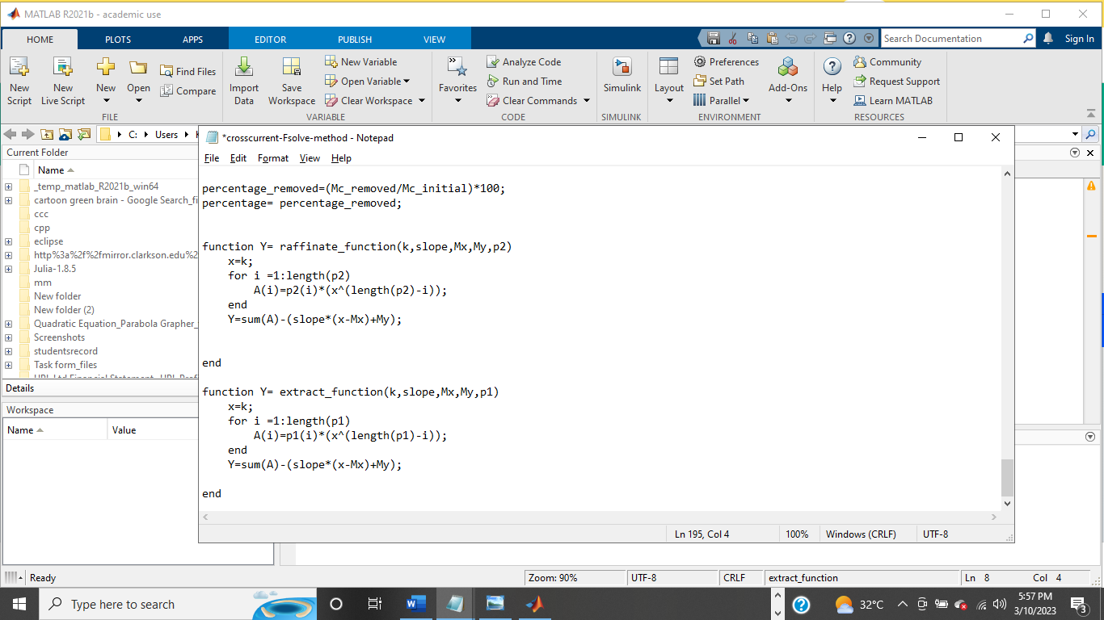
Cont…
Creating separate functions in different .m files for using the fzero for raffinate and extract curves raffinate_function extract_function

Slide 13
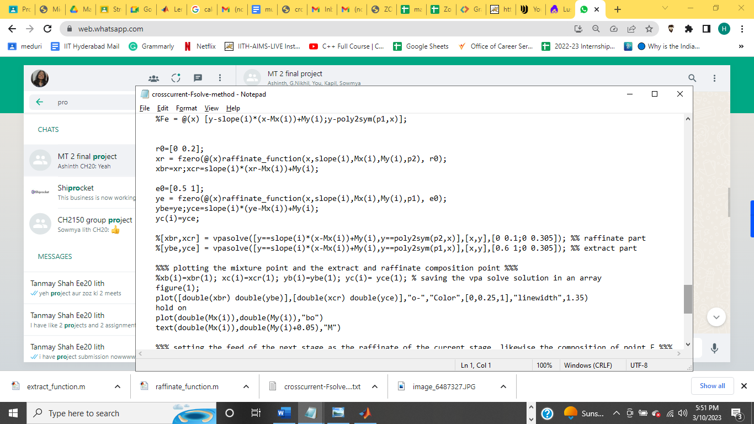
Cont…
Using the functions created in the last slide in the main code

Slide 14
05
Code Explanation

Slide 15
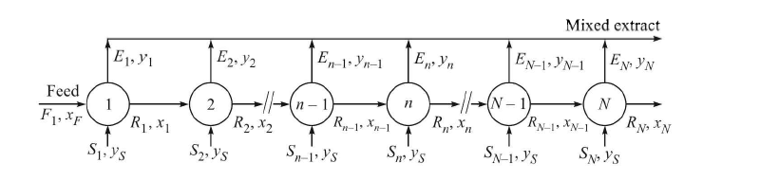
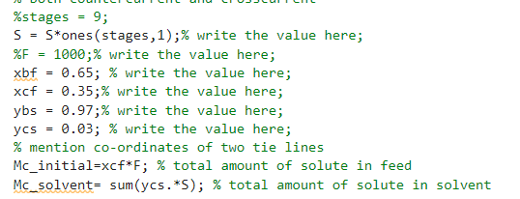
crosscurrent_Fsolve_func
Setting up the values of concentrations of B and C in the feed and solvent
Conc of B and C can be changed according to the need of the user
Amount of solute, feed and number of stages is given as the input to this function

Slide 16
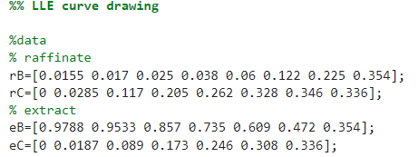
Drawing the LLE curve which is broken down into raffinate and extract curves based on the given equilibrium data

Slide 17
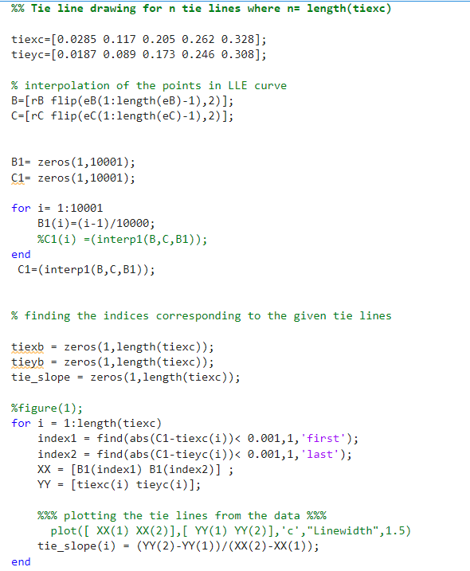
Since only y coordinates of tie lines are given we found the x coordinates from interpolation from the given equilibrium data using interp1 function
After that since all the coordinates of the tie lines are known, we calculated the slope of each tie line

Slide 18
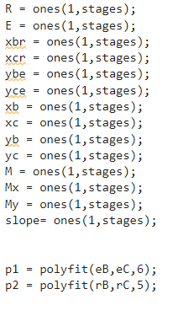
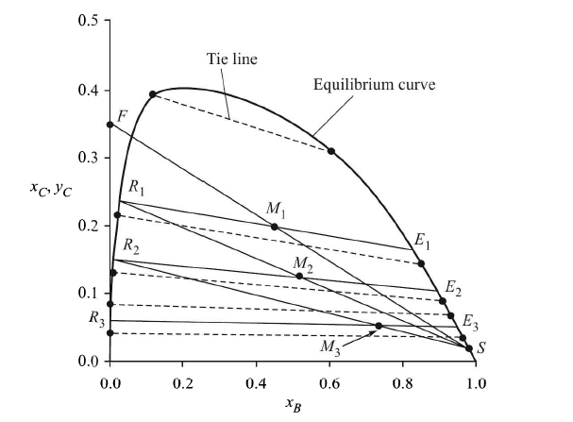
Initialising the variables which change their values for every stage like the coordinates of mixture, extract and raffinate points and their concentrations and amounts, slope of the tie line through the mixture point, etc.,
Fitting the extract and raffinate curves into a polynomials of degree 6 and 5

Slide 19
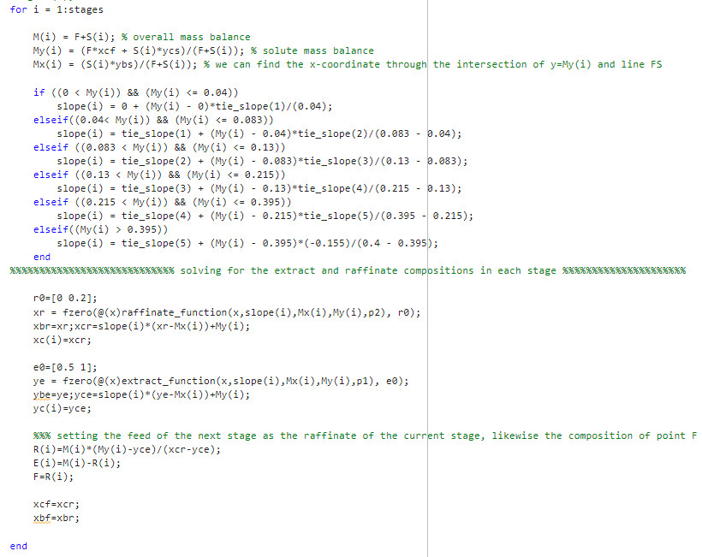
Creating a for loop which runs n = stages times
First we found the M (conc and coords) at each stage
Then, found in which of the given tie lines does the M point fall and interpolated the slope from those 2 given tie lines
After which we found R and E - conc and coords using fzero function
Finally set the conc of raffinate = feed for the next stage

Slide 20
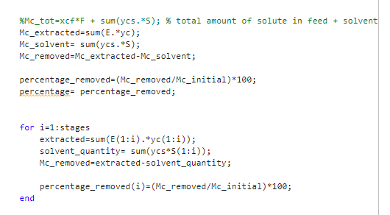
Finally find the amount of solute removed totally and at each stage (explained in section 03 of this presentation)
Output = Final E and R conc, amounts and percentage removal

Slide 21
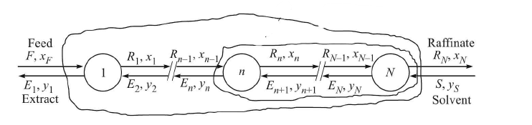
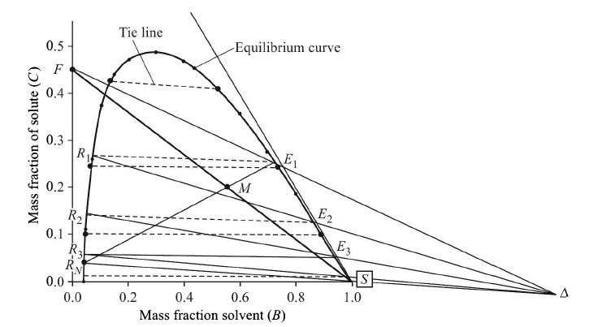
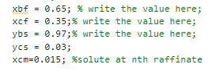
countercurrent_Fsolve_func
Setting up the values of concentrations of B and C in the feed and solvent and the conc of solute at the nth stage in the raffinate
Conc of B and C can be changed according to the need of the user
Amount of solute, feed and number of stages is given as the input to this function

Slide 22
Drawing the LLE curve which is broken down into raffinate and extract curves based on the given equilibrium data

Slide 23
Since only y coordinates of tie lines are given we found the x coordinates from interpolation from the given equilibrium data using interp1 function
After that since all the coordinates of the tie lines are known, we calculated the slope of each tie line

Slide 24
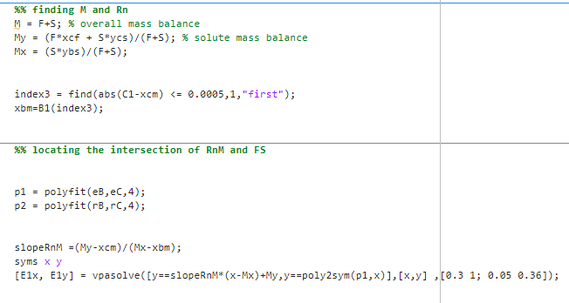
Find M and Coordinate of point corresponding to the nth stage raffinate solute conc
Fitting the curve using polyfit as 2 different curves for extract and raffinate
Finding slope of RnM and using vpasolve to find E1 coords

Slide 25
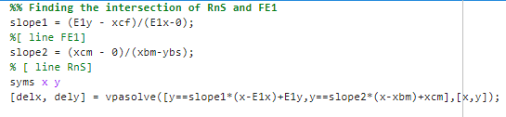
Finding the delta point from intersection of RnS and FE1 lines

Slide 26
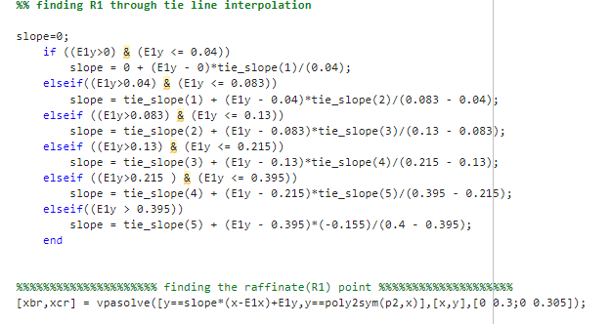
Finding the tie line passing through E1 to find R1 using tie line interpolation

Slide 27
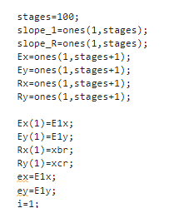
Initialising the variables which change their values for every stage like the coordinates of extract and raffinate points and their concentrations and amounts, slope of the tie line through the Raffinate coord, etc.,

Slide 28
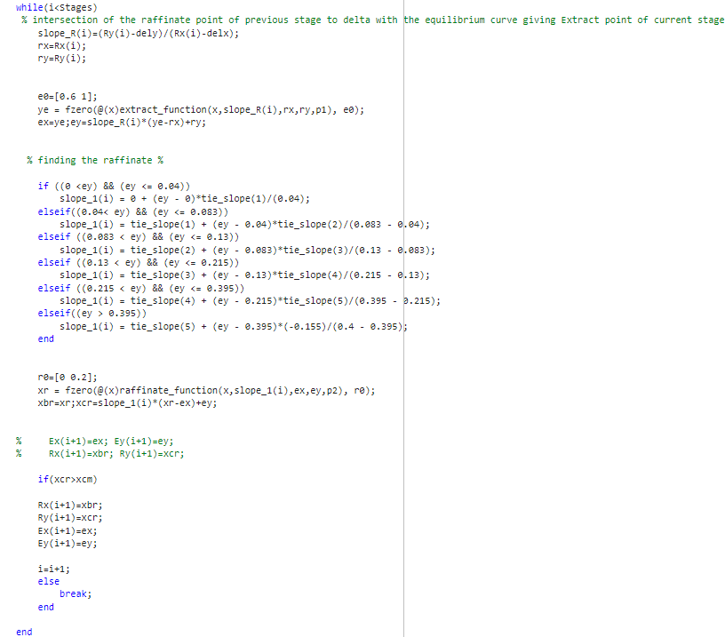
In the while loop
We first join the Raffinate point with delta point and find the extract point
Then we draw the tie line through the extract point
Running a while loop till the final raffinate conc of solute is more than the required nth stage raffinate conc

Slide 29
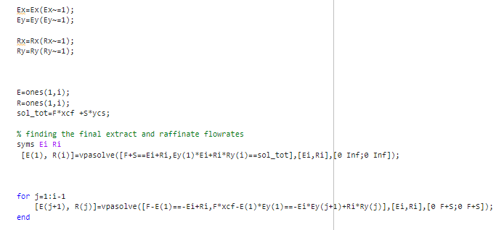
Finding the amount of extract and raffinate at each stage

Slide 30
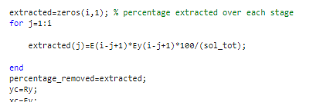
Finally find the amount of solute removed totally and at each stage (explained in section 03 of this presentation)
Output = Final E and R conc, amounts and percentage removal

Slide 31
max_stages_countercurrent_LLE
Everything else is similar to the countercurrent_Fsolve_func but,
With the assumption that the nth raffinate should not have more than 1.5% of solute, we determine the stages obtained as the maximum stages and then is used as a safety check in case the user has inputted a value too high.

Slide 32
The GUI

Slide 33
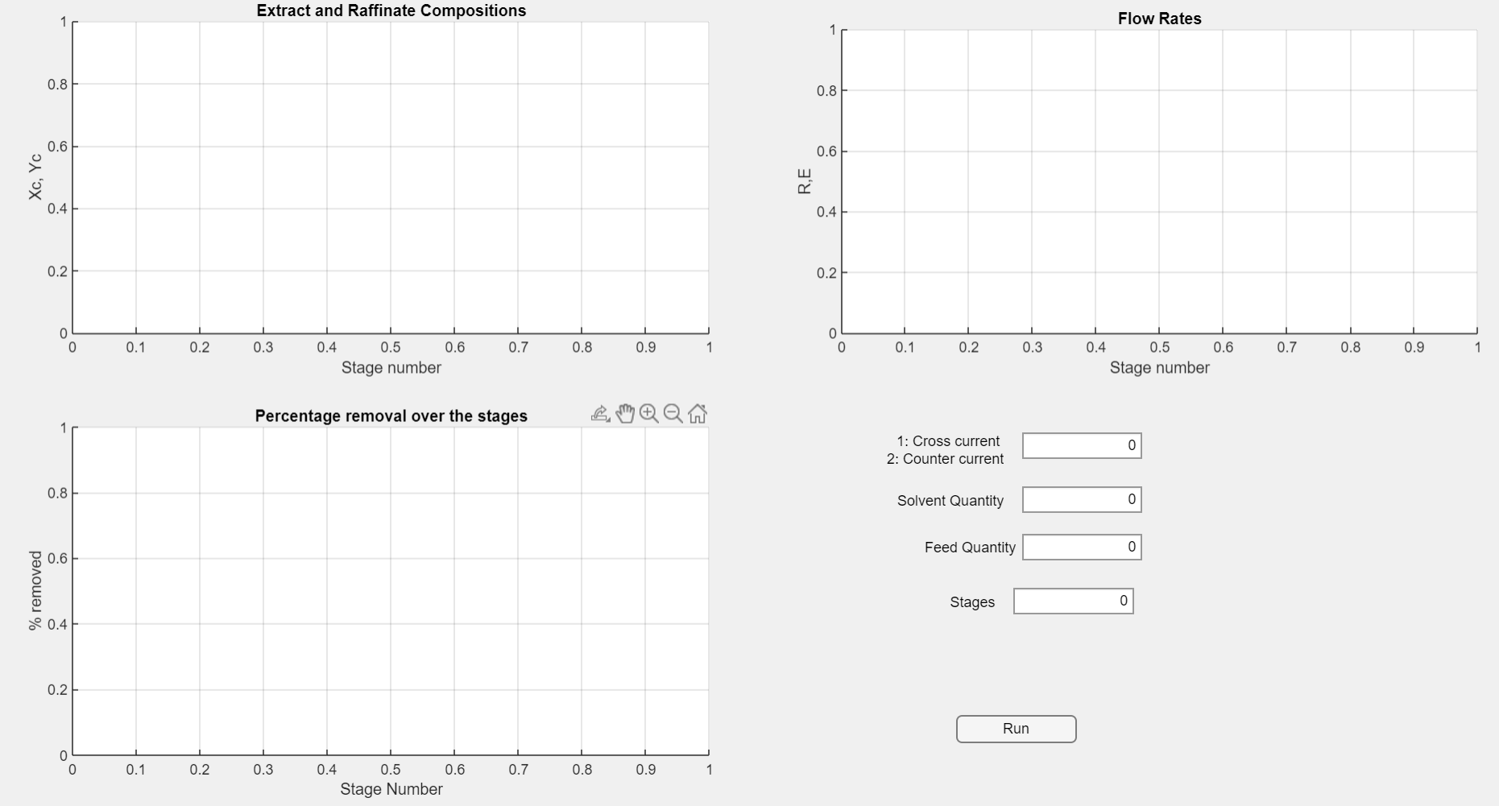
This app is made in matlab through MATLAB GUI, it contains the inputs as the Feed and Solvent Flow rates the number of stages and an option to choose between Crosscurrent ( denoted as 1 ) and countercurrent (denoted as 2). Then the application takes the input to the respective functions and provides the three plots for each stage.

Slide 34
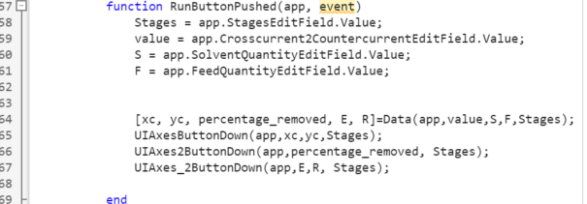
The files and functions created for the application
Project_1_final_exported(A)
This is the GUI’s .m file one has to run to start the application. The function for the Run button has been linked to the respective solvers depending on the input received from the user.
Data is another function that links the Run
Button function to the solvers. From this We get the values necessary for plotting (line 64)
They are called under the Data function in the first file with the inputs(value,F,S,Stages) being given, when value equals 1, the crosscurrent_Fsolve_func gets executed. When it is 2 the countercurrent_Fsolve_func gets executed (but there is another condition when value is 2)

Slide 35
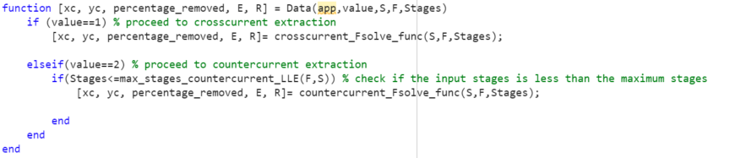
Contd..
countercurrent_Fsolve_func and crosscurrent_Fsolve_Func(B)
Both the functions have the same input (F, S, stages) and for the given equilibrium data the final flow rates of each stage, the percentage extracted, and the solute fraction in each stage is determined and these arrays are returned back to the main GUI file(project_1_final_exported).
In addition to this, both of these functions have the fzero solver implemented, which will call either of the 2 functions for solving the raffinate equation or the extract equation (the tie line interpolations). The two functions being “raffinate_function” and “rxtract_function” respectively, as their code snippets were shown previously .
The function names might be misleading as we use fzero solver in the function rather than fsolve.
Shown below is the function call depending on the “value” the user provides in the main GUI file.

Slide 36
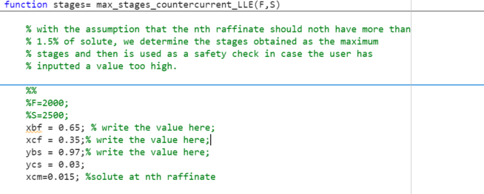
Contd..
max_stages_countercurrent_LLE
Returns one value, that is the maximum number of stages possible in the countercurrent option.
On closer inspection of the code snippet in the previous slide, one might ask the purpose of this in the “if” statement. This function checks for the maximum number of stages that are possible for a given feed (F) and raffinate ( R ) flow rates.
The maximum number is taken with respect to the final raffinate solute concentration being no less than 1.5%. So if the inputted number of stages is less than the maximum stages, then we can proceed with the calculation, otherwise the process will be terminated.
This is almost an equivalent of checking the minimum solvent rate that is possible for a feed and final raffinate composition.

Slide 37
Black Box model (ANN model)

Slide 38
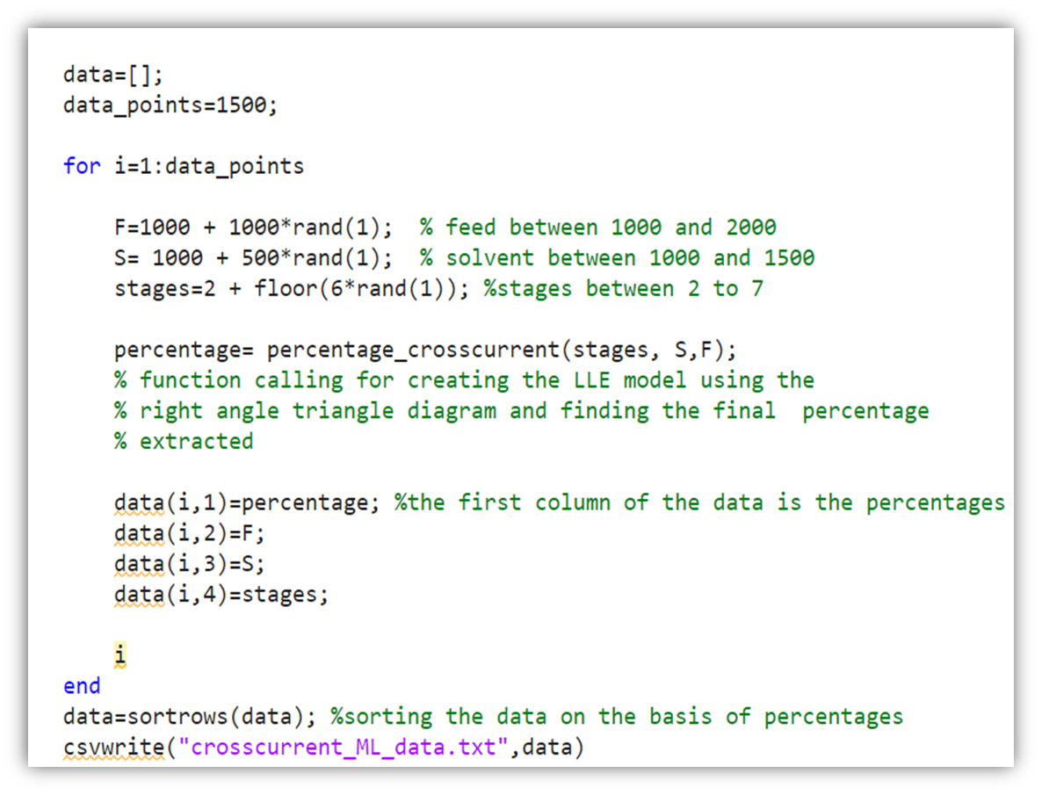
Generating Data for the model
The number of points is set to 1500, and we can modify the ranges of feed, solvent and the stages needed.
Rand function is used to remove any sort of bias in the data, which will affect the model and lead to incorrect predictions.
The final matrix is stored in a csv format and is imported into a python environment to fit and predict with the ANN model.

Slide 39
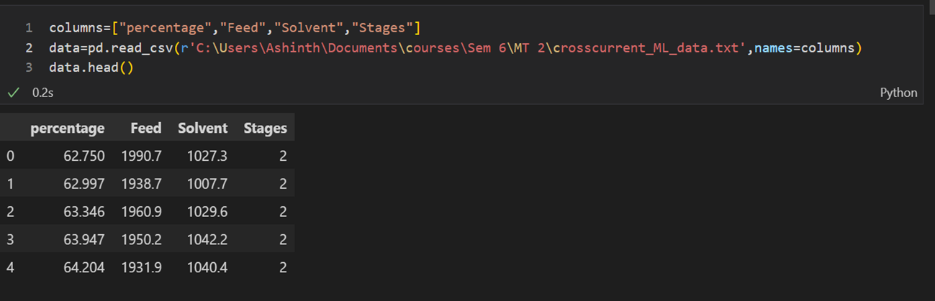
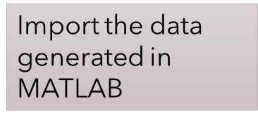
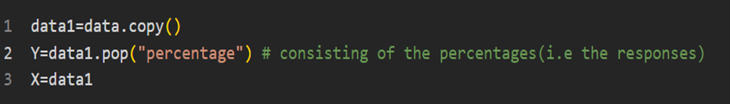
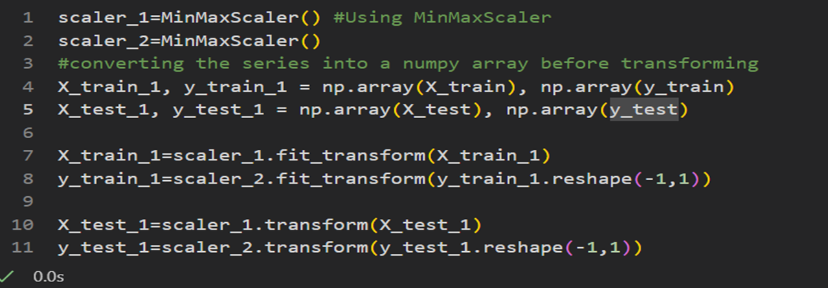
Data for the
ANN model
After importing the data, we need to separate the data into predictors and responses, with the predictors being:- the Feed flow rate, Solvent flow rate, number of stages. The output response is the percentage of solute extracted.
Then splitting the data into the training to testing (80:20 in this case) .
Prior to fitting the model, we also scale the data, otherwise the results of the model would be highly inconsistent
Separating the data ->
Scaling ->

Slide 40
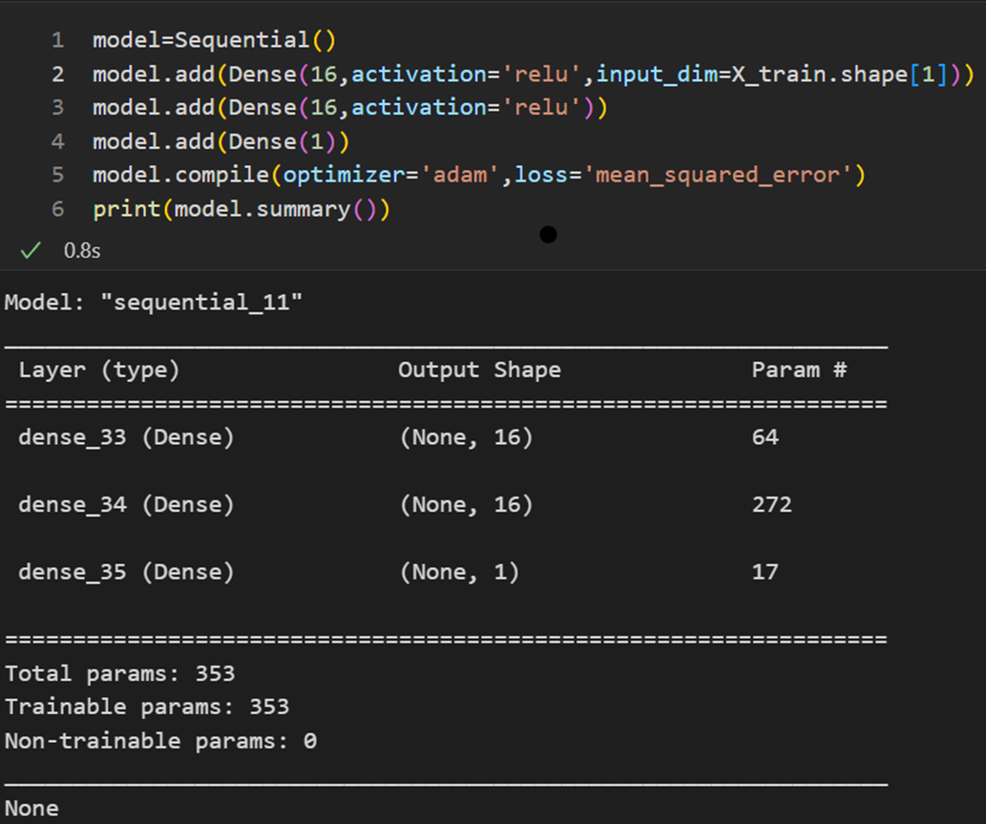
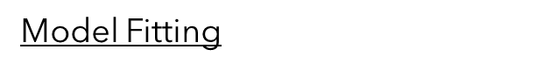
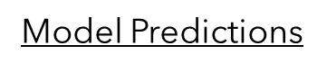
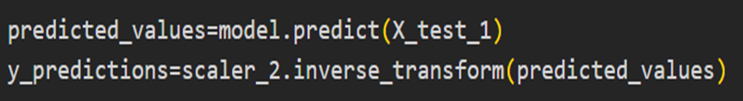
Creating and Fitting the ANN model
A sequential neural network having two hidden layers, each with 16 neurons, making up a total of 353 parameters. The optimizer being adam and loss metric being mean square error.
Setting the number of epochs as 100 (can be varied).
Data is transformed back one they are used for the model predictions.

Slide 41
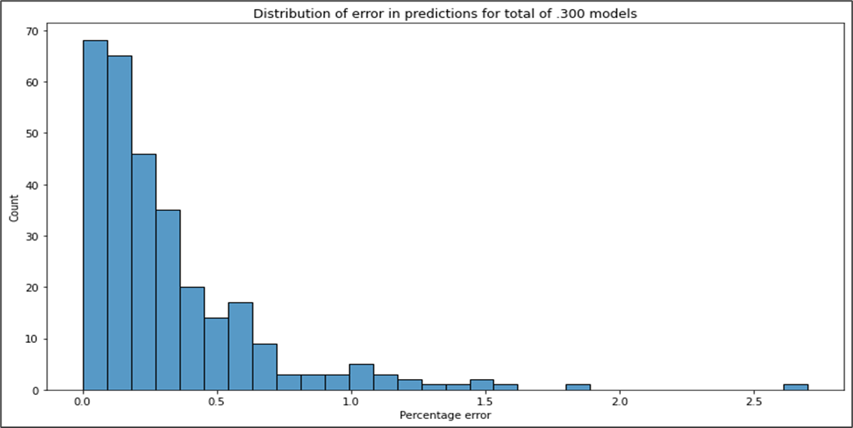
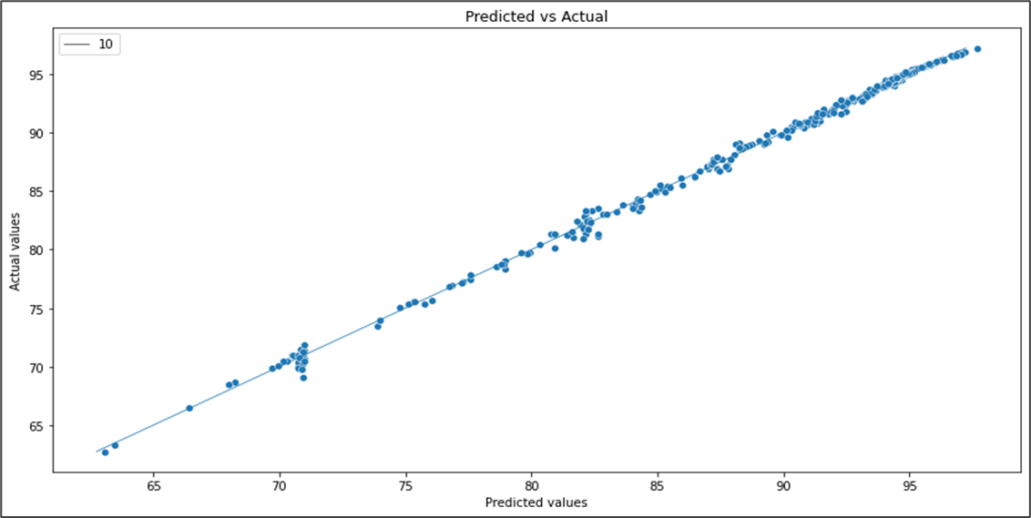
Errors in Predictions
For the testing data, once we do the predictions, we compare the predicted values to the actual values generated by solving the balance equations in MATLAB.
For comparison, we take the distribution of error ,i.e
(difference in values)*100/actual value.
In addition to that we also directly compare the values with respect to y=x.

Slide 42
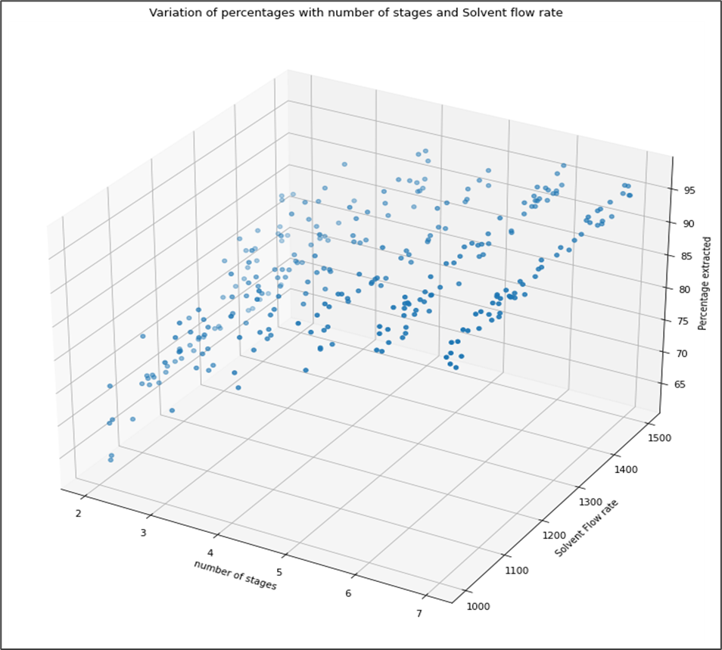
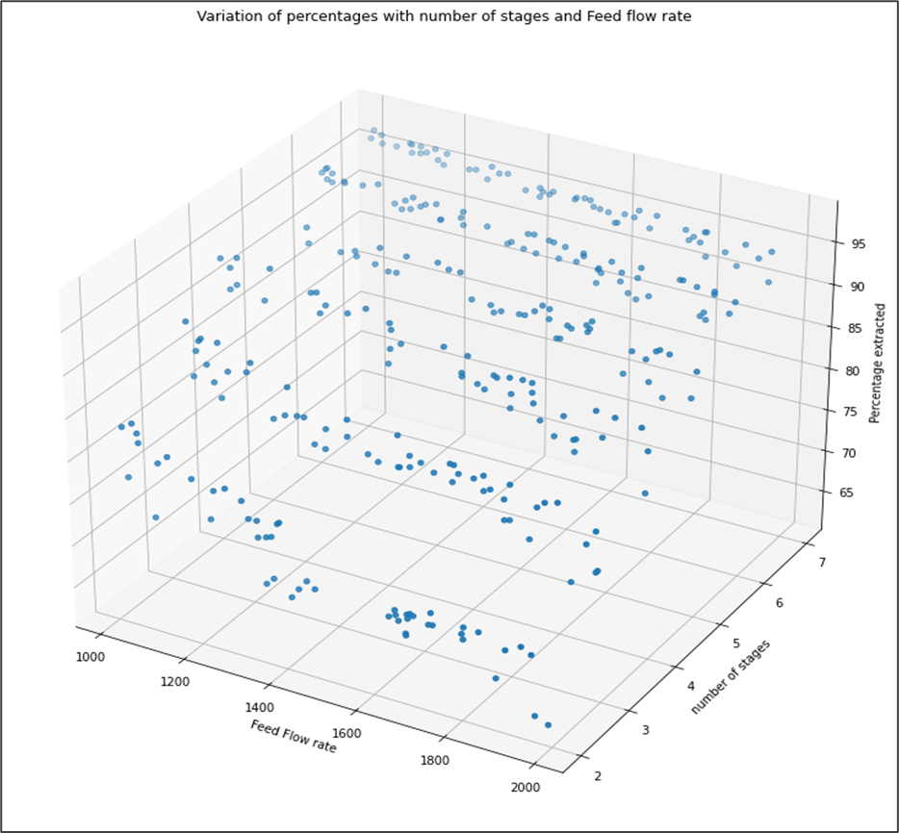
Variations among the input data
We compare how the percentages vary with the number of stages, feed and solvent flow rates
From the plots below, we can clearly observe an increase in percentage extracted with increase in stages.

Slide 43
05
Results Obtained

Slide 44
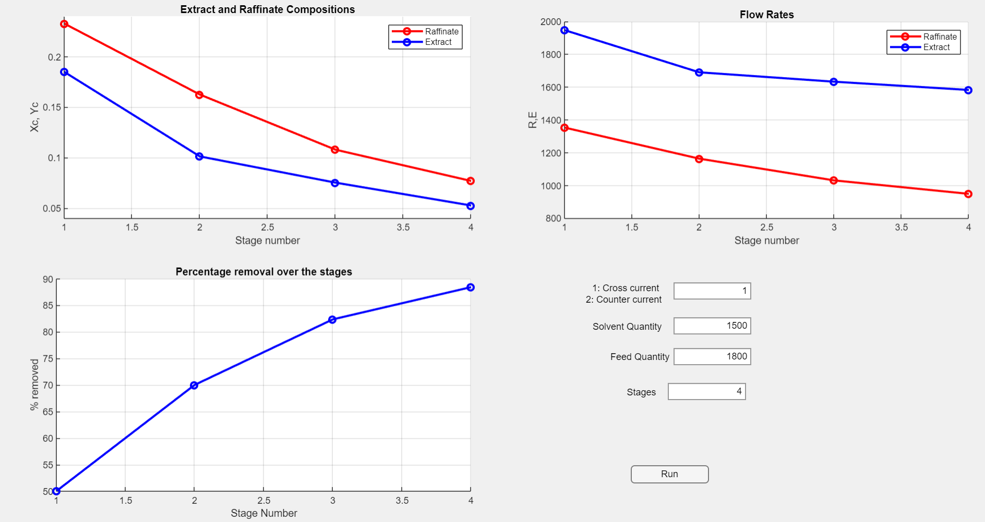
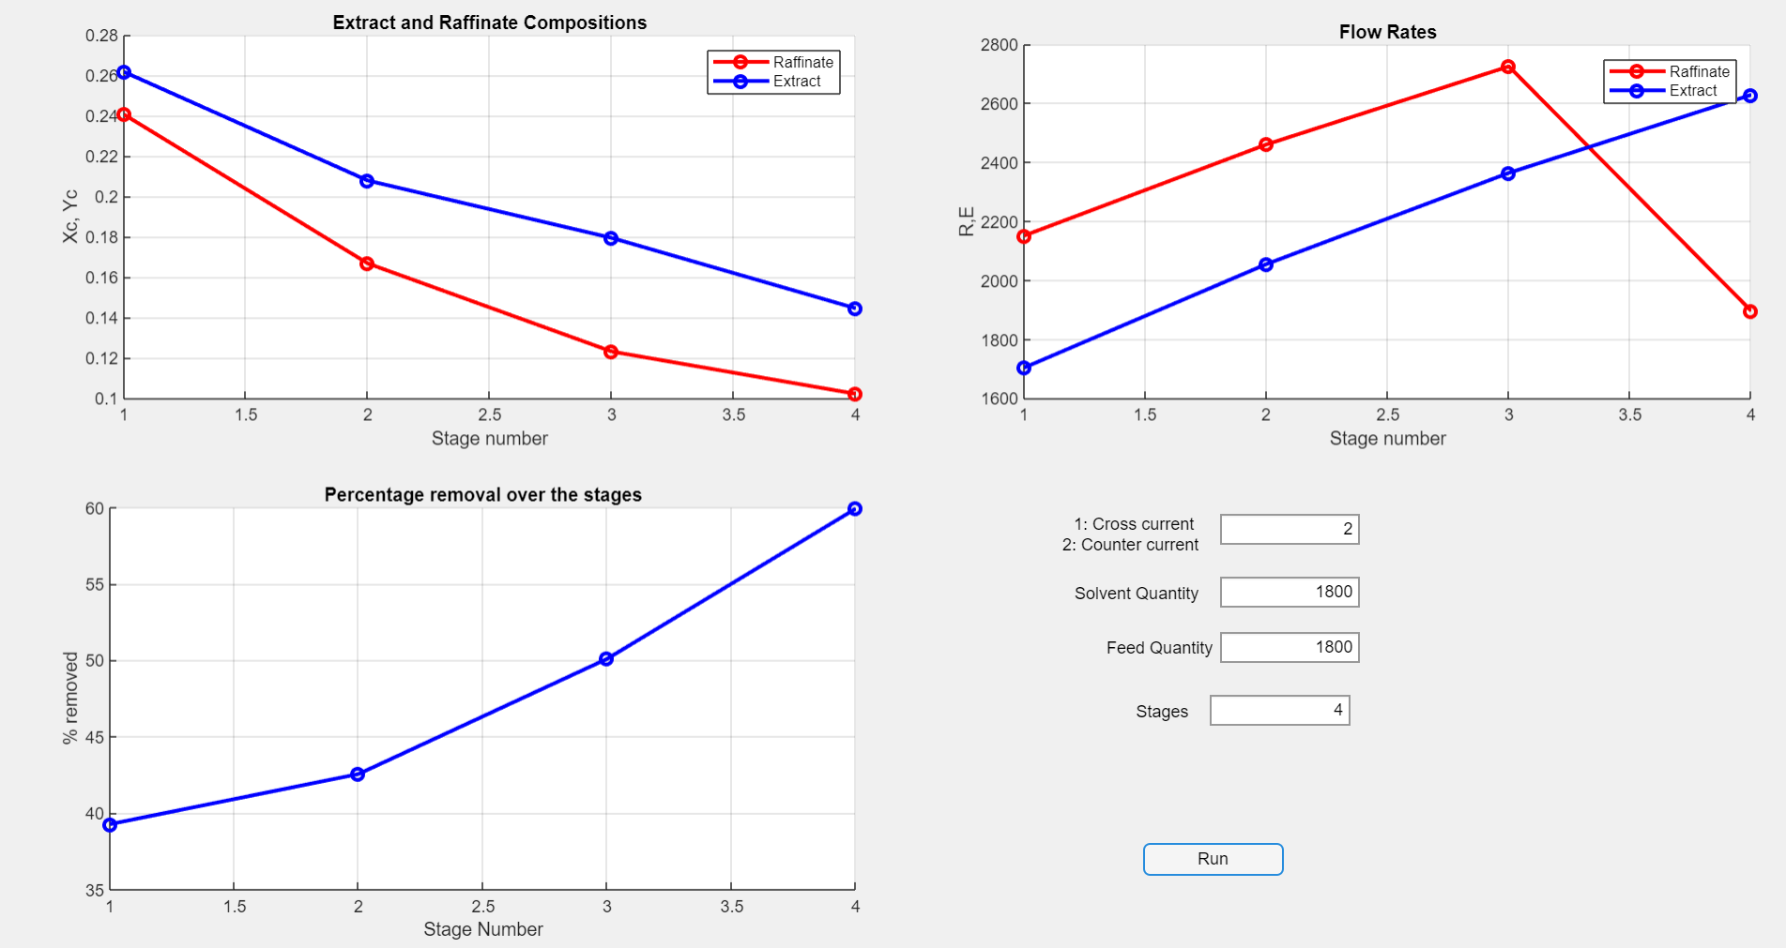
Graphs from the GUI
Cross current Extraction
Counter current Extraction

Slide 45
Shortcomings
The heatmap of the concentration of solute for each stage could not be plotted in the GUI since the current version of MATLAB does not support heatmap into the GUIAxes
The input data to the GUI does not contain the equilibrium value option, hence the equilibrium data will remain fixed.

Slide 46
Thank you!

